Slide 1
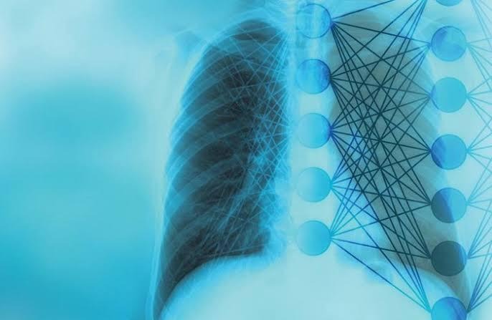
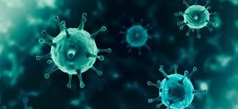
Presented by SNEHA.V-2019PECCS190 SIVAGAMA SUNDARI.V-2019PECCS188
PNEUMONIA DETECTION FROM CHEST X-RAY IMAGES USING DEEP LEARNING

Slide 2
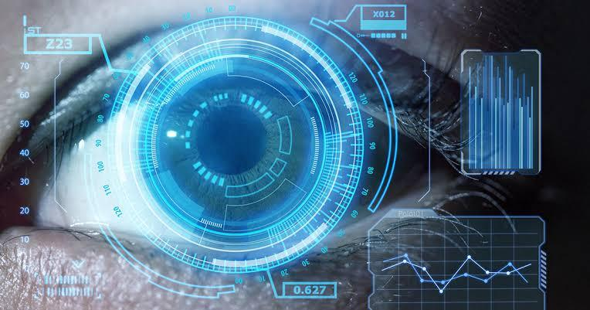
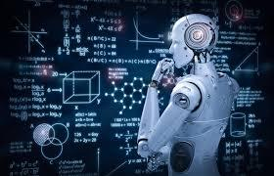
INTRODUCTION TO DOMAIN
COMPUTER VISION -Computer vision is a field of artificial intelligence (AI) that enables computers and systems to derive meaningful information from digital images, videos and other visual inputs .
MACHINE LEARNING –Machine learning is a branch of artificial intelligence (AI) and computer science which focuses on the use of data and algorithms to imitate the way that humans learn, gradually improving its accuracy.

Slide 3
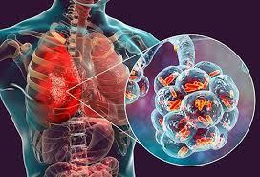
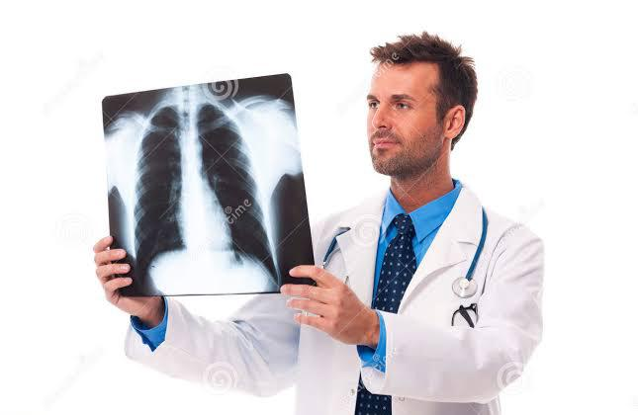
PROBLEM STATEMENT
Older adults and people who have severe underlying medical conditions or prior cases of pneumonia seem to be at higher risk.
With the growing technological advancements we have in this day and age, it is possible to use tools based on deep learning frameworks to detect pneumonia based on chest x-ray images.
The challenge here would be to aid the diagnosis process which allows for expedited treatment and better clinical outcomes.

Slide 4
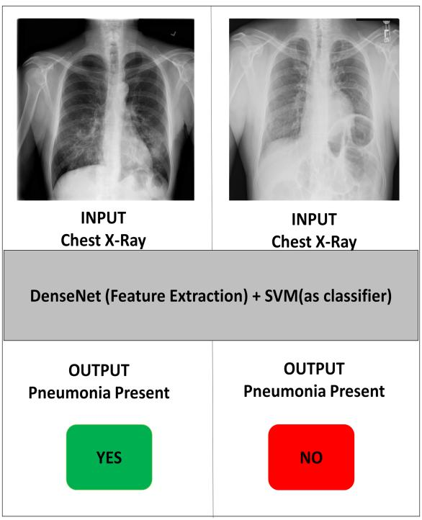
EXISTING SYSTEM
Existing systems predicts whether the victim has a traces of pneumonia or not.
It shows whether pneumonia traces are present or not.
It does not specify the type of infection.

Slide 5
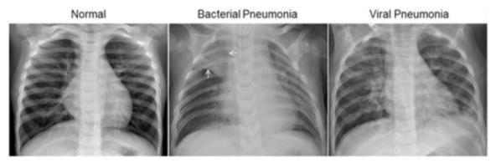
PROPOSED SYSTEM
We have created a Convolutional Neural Network Model which is able to correctly predict that the patient is suffering from Pneumonia or not by using that person’s chest X-ray.
So, in this project we have learned how to create CNN models and also learn how to generate data using ImageDataGenerator

Slide 6
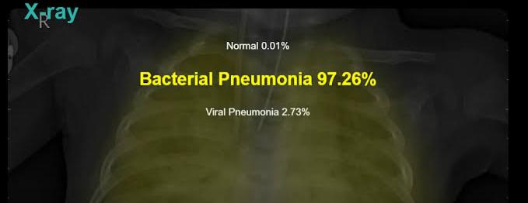
SOCIAL RELEVANCE
Our deep learning model is able to classify the image with 91% accuracy.
So the model we have created works fine on classifying the data it has never seen before.
So we can use this model to predict whether the person is Normal or suffering from Pneumonia with the help of that person’s Chest X-ray image

